Slide 1
SUBQUERY

Slide 2

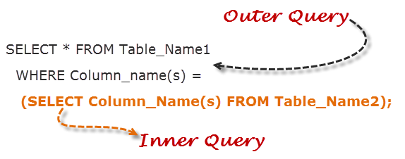
LEARNING GOALS
By the end of this lecture students should be able to:
Understand subqueries in SQL Server
Use smoothly subqueries and apply to real projects

Slide 3

Lesson Agenda
What is a subquery?
Type of Subqueries
Common cases use subquery
Rules that subqueries must follow

Slide 4
What’s a subquery?
Section 1

Slide 5
What Is A subquery?
A sub-query, also called an inner query, is a SQL query nested inside a larger query.
The subquery can be nested inside a SELECT, INSERT, UPDATE, or DELETE statement or inside another subquery.
You can use the comparison operators, such as >, <, or =. The comparison operator can also be a multiple-row operator, such as IN, ANY, or ALL.
Notes:
4

Slide 6
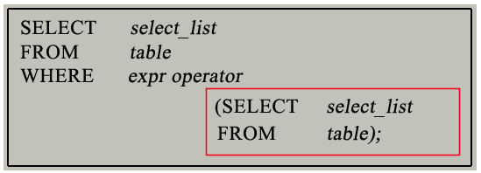
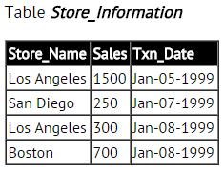
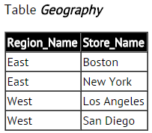
What Is A subquery?
Syntax (example: subquery within the Where) :
Exam:
Sale_Sum
2050
SELECT SUM (Sales) AS Sale_Sum FROM Store_Information
WHERE Store_Name IN
(SELECT Store_Name FROM Geography WHERE Region_Name = 'West');
Notes:
4

Slide 7
What Is A subquery? (3/3)
How to work?:
Inner query is independent of outer query.
Inner query is executed first and the results are stored.
Outer query then runs on the stored results.
Note about specific type: Correlated subqueries (be mentioned in the next slides)
Notes:
4

Slide 8
Type of Subqueries
Section 2

Slide 9
Subquery Types
Single row subquery
Multiple row subquery
Multiple column subquery
Correlated subquery
Nested subquery
Notes:
4

Slide 10
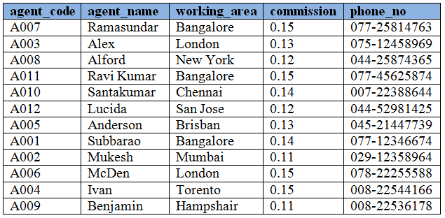

Single row subquery
A single row subquery returns zero or one row to the outer SQL statement. You can place a subquery in a WHERE clause, a HAVING clause, or a FROM clause of a SELECT statement.
Exam: Single Row subqueries in WHERE clause
SELECT agent_name, agent_code, phone_no
FROM agents
WHERE agent_code =
(SELECT agent_code FROM agents WHERE agent_name = 'Alex')
agents
Notes:
4

Slide 11
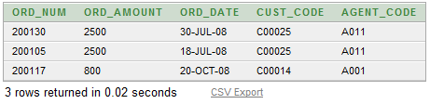
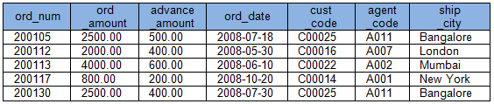
Multiple row subquery
Multiple row subquery returns one or more rows to the outer SQL statement. You may use the IN, ANY, or ALL operator in outer query to handle a subquery that returns multiple rows.
Ex: Multiple row Subquery in a WHERE clause
SELECT ord_num, ord_amount, ord_date, cust_code, agent_code
FROM orders
WHERE agent_code IN (
SELECT agent_code FROM agents
WHERE working_area='Bangalore'
)
orders
Notes:
4
HAVING clause is used to filter groups of rows. You may place a subquery in HAVING clause in an outer query. This allows you to filter groups of rows based on the result returned by your subquery. The following example uses a subquery in the HAVING clause of the outer query. This example retrieves 'ord_amount, number of agent_codes and agent_code' from the table orders with following conditions :
- agent_code of orders table must come distinctly. - average of ord_amount of each group of agent_code in orders table must be equal to the average ord_amount of orders table. - agent_code of orders table must be 'A008'.
- See more at: http://www.w3resource.com/sql/subqueries/single-row-subqueries.php#sthash.V4cNbrzU.dpuf

Slide 12
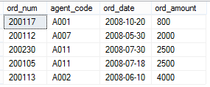
Multiple column subquery
You can write subqueries that return multiple columns.
Ex: Multiple column Subquery in a FROM clause
SELECT ord_num, agent_code, ord_date, ord_amount
FROM orders o1
WHERE EXISTS(
SELECT agent_code, ord_amount
FROM orders o2
WHERE o1.agent_code = o2.agent_code
AND o1.ord_amount = o2.ord_amount
)
ORDER BY ord_amount ASC
Notes:
4
HAVING clause is used to filter groups of rows. You may place a subquery in HAVING clause in an outer query. This allows you to filter groups of rows based on the result returned by your subquery. The following example uses a subquery in the HAVING clause of the outer query. This example retrieves 'ord_amount, number of agent_codes and agent_code' from the table orders with following conditions :
- agent_code of orders table must come distinctly. - average of ord_amount of each group of agent_code in orders table must be equal to the average ord_amount of orders table. - agent_code of orders table must be 'A008'.
- See more at: http://www.w3resource.com/sql/subqueries/single-row-subqueries.php#sthash.V4cNbrzU.dpuf

Slide 13

Correlated subquery
Reference one or more columns in the outer SQL statement. The subquery is known as a correlated subquery because the subquery is related to the outer SQL statement.
Ex: Correlated Subquery in a FROM clause
SELECT * FROM orders o
WHERE agent_code IN (
SELECT agent_code FROM agents a
WHERE o.ship_city = a.working_area
)
Result:
Notes:
4
HAVING clause is used to filter groups of rows. You may place a subquery in HAVING clause in an outer query. This allows you to filter groups of rows based on the result returned by your subquery. The following example uses a subquery in the HAVING clause of the outer query. This example retrieves 'ord_amount, number of agent_codes and agent_code' from the table orders with following conditions :
- agent_code of orders table must come distinctly. - average of ord_amount of each group of agent_code in orders table must be equal to the average ord_amount of orders table. - agent_code of orders table must be 'A008'.
- See more at: http://www.w3resource.com/sql/subqueries/single-row-subqueries.php#sthash.V4cNbrzU.dpuf

Slide 14

Nested subquery
A subquery can be nested inside other subqueries.
Ex: Nested Subquery in a WHERE clause
SELECT *
FROM orders
WHERE ship_city IN (
SELECT DISTINCT working_area FROM agents
WHERE agent_code IN (
SELECT agent_code FROM agents
WHERE commission >= 0.14
)
)
Result:
Notes:
4
HAVING clause is used to filter groups of rows. You may place a subquery in HAVING clause in an outer query. This allows you to filter groups of rows based on the result returned by your subquery. The following example uses a subquery in the HAVING clause of the outer query. This example retrieves 'ord_amount, number of agent_codes and agent_code' from the table orders with following conditions :
- agent_code of orders table must come distinctly. - average of ord_amount of each group of agent_code in orders table must be equal to the average ord_amount of orders table. - agent_code of orders table must be 'A008'.
- See more at: http://www.w3resource.com/sql/subqueries/single-row-subqueries.php#sthash.V4cNbrzU.dpuf

Slide 15
Common cases use subquery
We focus on some typical usecases for Subquery:
Subqueries with Aliases: Many statements in which the subquery and the outer query refer to the same table
Subqueries with IN / NOT IN: The result of a subquery introduced with IN (or with NOT IN) is a list of zero or more values. After the subquery returns results, the outer query makes use of them
Subqueries with EXISTS / NOT EXISTS: The subquery functions as an existence test.
Subqueries in UPDATE, DELETE, INSERT, SELECT
Notes:
4

Slide 16
Rules that subqueries must follow
You must enclose a subquery in parenthesis.
A subquery must include a SELECT clause and a FROM clause.
Subqueries that return more than one row can only be used with multiple value operators, such as the IN operator.
A subquery can include optional WHERE, GROUP BY, and HAVING clauses.
A subquery cannot include COMPUTE or FOR BROWSE clauses.
You can include an ORDER BY clause only when a TOP clause is included.
You can nest subqueries up to 32 levels.
Notes:
4

Slide 17
SUMMARY
Overview of Subquery
Type of Subqueries
Common cases use subquery
Rules that subqueries must follow

Slide 18

Q&A Thank you
18

